Slide 1
Hamlet Revitalization Update
209 Rt 17
The Junction

Slide 2
Hamlet Revitalization Update
Tuxedo LDC Initiatives
Traffic Flow/Street Study Burgis Group 2022
Town Board Street Study 2023
Creighton Manning Infrastructure
Greenway Economic Study
Economic Development Program

Slide 3
NY Forward Grant Pivotal Transformative Projects
-Walkability and Connectivity
-Beautification-Landscaping, Lighting, Wayfaring
-Public /Private Projects to Stimulate Economic Growth
Cultural and Recreational Events and Programs
-Marketing Programs

Slide 4
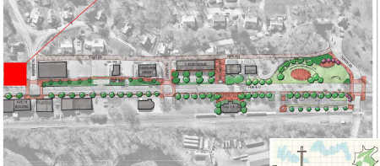
Creighton Manning Sketch Plan

Slide 5
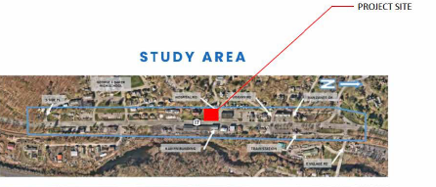
209 Rt “ The Junction”

Slide 8
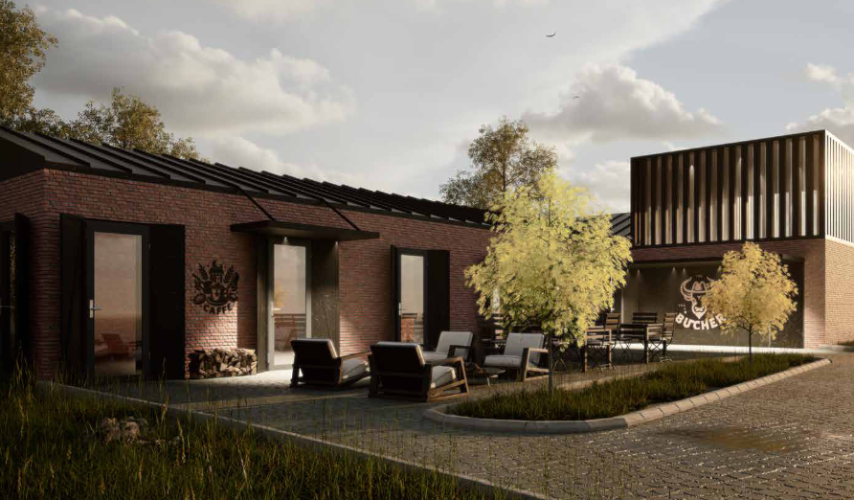

Slide 9
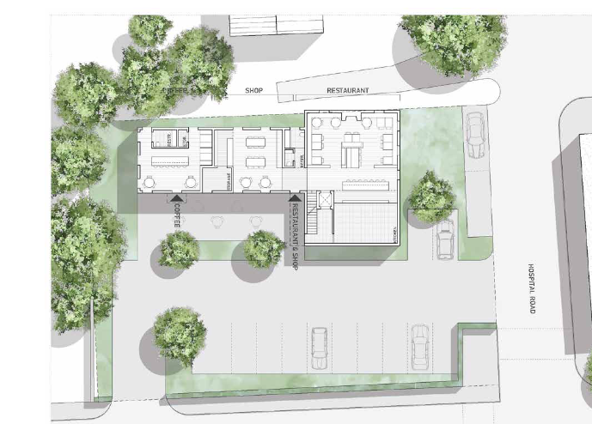

Slide 10
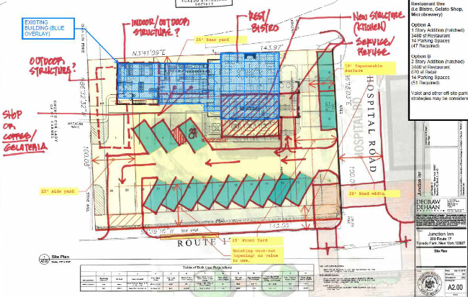

Slide 12
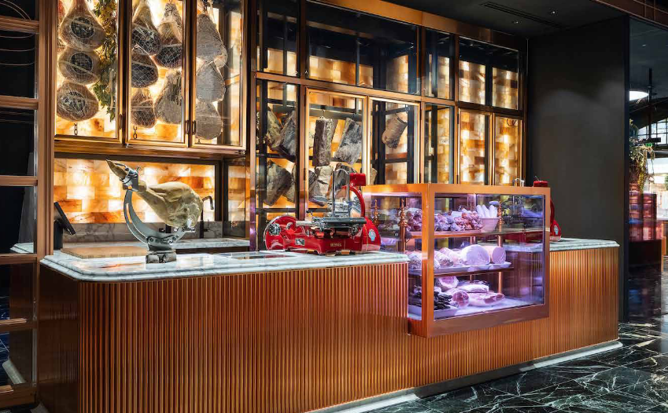

Slide 13
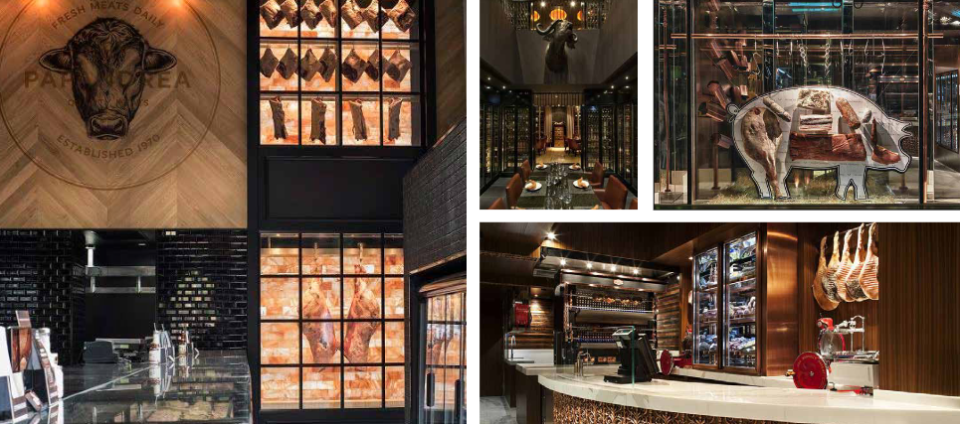

Slide 14
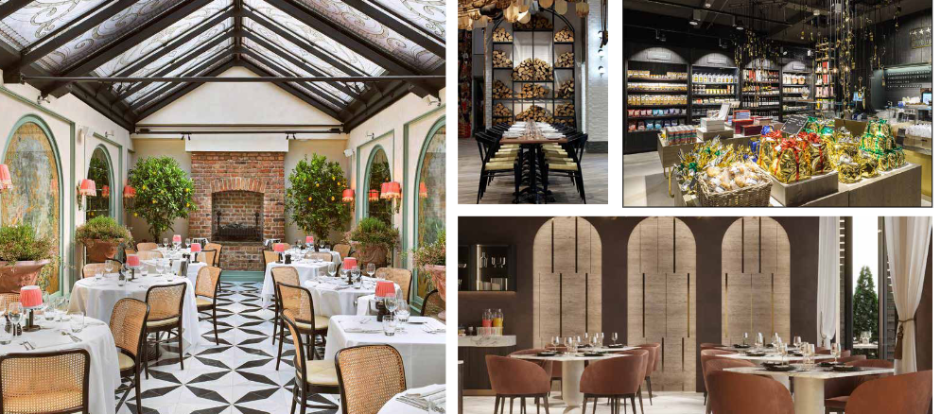

Slide 17
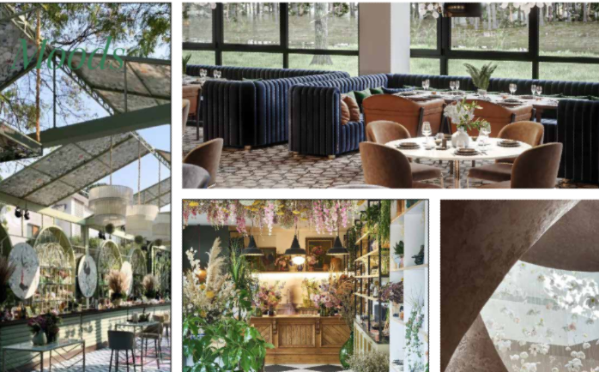

Slide 18
Hamlet Revitalization Funding
Tuxedo LDC Grants
NY Forward Grant and Other State and Federal Grant Opportunities
Municipal Bond

Slide 19
Hamlet Revitalization Funding
BAN
Short Term interest bearing security in advance of future bond
One Year, One Payment
Roll over options 2 years

Slide 20
Hamlet Revitalization Next Steps/Timeline
Creighton Manning Presentation September 16
NY Forward Grant Application October 18
Junction Budget/Buildout September 9
Hamlet Parking Plan TBD
Economic Development Ongoing

